Slide 1

UNIT – II Introduction to Problem Solving
FYBTECH
Subject : Programming and Problem Solving

Slide 2
Unit 2 Contents
Problem solving process/framework, Algorithms, Pseudo-code and flowchart, Case study for Algorithm, flowchart and pseudo code: calculate slope of a line, Factorial, Fibonacci, snake and ladder, tic-tac-toe. Top down and Bottom up design approach, Software Development life cycle, Programming paradigms: Imperative, object oriented, functional and logic programming. Role of programming languages, need to study programming languages, Characteristics of Programming Languages.

Slide 3
Computer Programming– Three Stages
Computer programming can be divided into three distinct areas of activity:
Problem definition and problem solving
Creating a structured solution (or algorithm)
Coding (e.g. C, Java, C++)
Consider an example as case of customer while marketing
Specify the problem
Solve the problem
Specify solution in structured format

Slide 4
Problem Solving, Algorithm Development and Coding
In problem solving, algorithm development and coding we tend to view problems at different levels of abstraction.
Problem solving is done at a high level of abstraction. Much of the detail is omitted at this stage in order that the problem can be more easily specified and solved.
Algorithm development works at a lower level of abstraction than problem solving. It contains much of the detail that will eventually become the program. However, it still omits the finer detail required in the final compute program
Coding works at a very low level of abstraction. Programming code must be written with every single detail a computer needs to carry out a task included.
Notes:
The Software Development Life Cycle (SDLC), or System Development Life Cycle in systems engineering, information systems and software engineering, is the entire process of formal, logical steps taken to develop a software product. The concept generally refers to computer or information systems.
Phases of SDLC The phases of SDLC include the following: 1. Problem Definition. 2. Program Design. 3. Coding. 4. Debugging. 5. Testing. 6. Documentation. 7. Maintenance. 8. Extension and Redesign
Problem Definition: Problem definition is the basic and primary step of software development life cycle. It includes the goal of system analysis and to determine where the problem is in an attempt to fix the system. This step involves "breaking down" the system in different pieces to analyze the situation. Requirements Gathering is also a step to be taken in this stage. Requirements Gathering sometimes requires individuals/teams from client as well as service provider sides to get detailed and accurate requirements.
2. Program Design: In systems, design functions and operations are described in detail, including screen layouts, business rules, process diagrams and other documentation. The output of this stage will describe the new system as a collection of modules or subsystems. The design stage takes as its initial input the requirements identified in the approved requirements document. Design elements describe the desired software features in detail, and generally include functional hierarchy diagrams, screen layout diagrams, tables of business rules, business process diagrams, pseudo code, and a complete entityrelationship diagram with a full data dictionary. Coding: Modular and subsystem programming code will be accomplished during this stage. Coding includes the application of various logic and internal work done by various specialists. This stage is intermingled with the next in that individual modules will need testing before integration to the main project Debugging: Debugging is the process of removing the errors that occurs during the coding part. Debugging is essential for this stage establishes the platform for further stages of development. Testing: The code is tested at various levels in software testing. Unit, system and user acceptance testing’s are often performed. This is a grey area as many different opinions exist as to what the stages of testing are and how much if any iteration occurs. Documentation: Documentation is the process of writing down every stages and each and every details of the process of life cycle development so that anyone who follows this process may be able to do it in the real sense. Documenting the internal design of software for the purpose of future maintenance and enhancement is done throughout development. Maintenance: Maintaining the system is an important aspect of SDLC. As key personnel change positions in the organization, new changes will be implemented, which will require system updates. Maintenance is the process of keeping the software in its fully functional form and see to that nothing goes wrong. Maintaining and enhancing software to cope with newly discovered problems or new requirements can take far more time than the initial development of the software Extension and Redesign: This is the last step of system design where there is always scope for extension and redesign whenever required. This stage allows for the extension of any part for the advancement of the software or so that the developed software does not become useless. This stage allows further designing and following all the steps again.

Slide 5
Contd…
Problem solving, algorithm development and coding are also different in terms of the language that is used to complete the activity:
Problem solving is generally done using use natural, everyday language
Algorithm development is done using a specialist, semi-structured language (pseudo code)
Coding is done using a highly-structured (programming) language that is readable by machines

Slide 6
What is a Problem?
There are many different kinds of problems:
How do I get to Oxford from London?
Why is it wrong to lie?
For a problem to be solvable through the use of a computer, it must generally:
Be technical in nature with objective answers that can be arrived at using rational methods
Be well-structured
Contain sufficient information for a solution to be found
Contain little, if any, ambiguity.
Notes:
Rational -based on or in accordance with reason or logic.

Slide 7
When Can You Use a Problem Definition?
Starting Point
Expected Outcome
Possible Procedure

Slide 8
How do We Solve Problems?
We need to THINK!
We need to engage in one or more of the following types of thinking:
Logical reasoning
Mathematical reasoning
Lateral thinking
Problem solving is easier if we employ a problem solving framework and an appropriate problem solving strategy to aid us.
Notes:
The Software Development Life Cycle (SDLC), or System Development Life Cycle in systems engineering, information systems and software engineering, is the entire process of formal, logical steps taken to develop a software product. The concept generally refers to computer or information systems.
Phases of SDLC The phases of SDLC include the following: 1. Problem Definition. 2. Program Design. 3. Coding. 4. Debugging. 5. Testing. 6. Documentation. 7. Maintenance. 8. Extension and Redesign
Problem Definition: Problem definition is the basic and primary step of software development life cycle. It includes the goal of system analysis and to determine where the problem is in an attempt to fix the system. This step involves "breaking down" the system in different pieces to analyze the situation. Requirements Gathering is also a step to be taken in this stage. Requirements Gathering sometimes requires individuals/teams from client as well as service provider sides to get detailed and accurate requirements.
2. Program Design: In systems, design functions and operations are described in detail, including screen layouts, business rules, process diagrams and other documentation. The output of this stage will describe the new system as a collection of modules or subsystems. The design stage takes as its initial input the requirements identified in the approved requirements document. Design elements describe the desired software features in detail, and generally include functional hierarchy diagrams, screen layout diagrams, tables of business rules, business process diagrams, pseudo code, and a complete entityrelationship diagram with a full data dictionary. Coding: Modular and subsystem programming code will be accomplished during this stage. Coding includes the application of various logic and internal work done by various specialists. This stage is intermingled with the next in that individual modules will need testing before integration to the main project Debugging: Debugging is the process of removing the errors that occurs during the coding part. Debugging is essential for this stage establishes the platform for further stages of development. Testing: The code is tested at various levels in software testing. Unit, system and user acceptance testing’s are often performed. This is a grey area as many different opinions exist as to what the stages of testing are and how much if any iteration occurs. Documentation: Documentation is the process of writing down every stages and each and every details of the process of life cycle development so that anyone who follows this process may be able to do it in the real sense. Documenting the internal design of software for the purpose of future maintenance and enhancement is done throughout development. Maintenance: Maintaining the system is an important aspect of SDLC. As key personnel change positions in the organization, new changes will be implemented, which will require system updates. Maintenance is the process of keeping the software in its fully functional form and see to that nothing goes wrong. Maintaining and enhancing software to cope with newly discovered problems or new requirements can take far more time than the initial development of the software Extension and Redesign: This is the last step of system design where there is always scope for extension and redesign whenever required. This stage allows for the extension of any part for the advancement of the software or so that the developed software does not become useless. This stage allows further designing and following all the steps again.

Slide 9
A Problem Solving Framework
An outline framework for problem solving:
Understand the problem
Devise a plan to solve the problem
Carry out the plan
Assess the result
Describe what has been learned from the process
Document the solution.
In Vickers, this framework is called the How to Think Like a Programmer (HTTLAP) approach to problem solving.
Notes:
The Software Development Life Cycle (SDLC), or System Development Life Cycle in systems engineering, information systems and software engineering, is the entire process of formal, logical steps taken to develop a software product. The concept generally refers to computer or information systems.
Phases of SDLC The phases of SDLC include the following: 1. Problem Definition. 2. Program Design. 3. Coding. 4. Debugging. 5. Testing. 6. Documentation. 7. Maintenance. 8. Extension and Redesign
Problem Definition: Problem definition is the basic and primary step of software development life cycle. It includes the goal of system analysis and to determine where the problem is in an attempt to fix the system. This step involves "breaking down" the system in different pieces to analyze the situation. Requirements Gathering is also a step to be taken in this stage. Requirements Gathering sometimes requires individuals/teams from client as well as service provider sides to get detailed and accurate requirements.
2. Program Design: In systems, design functions and operations are described in detail, including screen layouts, business rules, process diagrams and other documentation. The output of this stage will describe the new system as a collection of modules or subsystems. The design stage takes as its initial input the requirements identified in the approved requirements document. Design elements describe the desired software features in detail, and generally include functional hierarchy diagrams, screen layout diagrams, tables of business rules, business process diagrams, pseudo code, and a complete entityrelationship diagram with a full data dictionary. Coding: Modular and subsystem programming code will be accomplished during this stage. Coding includes the application of various logic and internal work done by various specialists. This stage is intermingled with the next in that individual modules will need testing before integration to the main project Debugging: Debugging is the process of removing the errors that occurs during the coding part. Debugging is essential for this stage establishes the platform for further stages of development. Testing: The code is tested at various levels in software testing. Unit, system and user acceptance testing’s are often performed. This is a grey area as many different opinions exist as to what the stages of testing are and how much if any iteration occurs. Documentation: Documentation is the process of writing down every stages and each and every details of the process of life cycle development so that anyone who follows this process may be able to do it in the real sense. Documenting the internal design of software for the purpose of future maintenance and enhancement is done throughout development. Maintenance: Maintaining the system is an important aspect of SDLC. As key personnel change positions in the organization, new changes will be implemented, which will require system updates. Maintenance is the process of keeping the software in its fully functional form and see to that nothing goes wrong. Maintaining and enhancing software to cope with newly discovered problems or new requirements can take far more time than the initial development of the software Extension and Redesign: This is the last step of system design where there is always scope for extension and redesign whenever required. This stage allows for the extension of any part for the advancement of the software or so that the developed software does not become useless. This stage allows further designing and following all the steps again.
Vickers was a famous name in British engineering that existed through many companies from 1828 until 1999. Vickers was a famous name in British engineering that existed through many companies from 1828 until 1999.

Slide 10
Understanding the Problem
To understand a problem
We need to read and reread it till we understand every detail
We need to dissect the problem into its component parts (e.g. problems and sub-problems)
We need to remove any ambiguity
We need to remove any information that is extraneous to the problem
We need to determine our knowns and our unknowns
We need to be aware of any assumptions we are making.
Notes:
Extraneous : irrelevant or unrelated to the subject being dealt with.
The Software Development Life Cycle (SDLC), or System Development Life Cycle in systems engineering, information systems and software engineering, is the entire process of formal, logical steps taken to develop a software product. The concept generally refers to computer or information systems.
Phases of SDLC The phases of SDLC include the following: 1. Problem Definition. 2. Program Design. 3. Coding. 4. Debugging. 5. Testing. 6. Documentation. 7. Maintenance. 8. Extension and Redesign
Problem Definition: Problem definition is the basic and primary step of software development life cycle. It includes the goal of system analysis and to determine where the problem is in an attempt to fix the system. This step involves "breaking down" the system in different pieces to analyze the situation. Requirements Gathering is also a step to be taken in this stage. Requirements Gathering sometimes requires individuals/teams from client as well as service provider sides to get detailed and accurate requirements.
2. Program Design: In systems, design functions and operations are described in detail, including screen layouts, business rules, process diagrams and other documentation. The output of this stage will describe the new system as a collection of modules or subsystems. The design stage takes as its initial input the requirements identified in the approved requirements document. Design elements describe the desired software features in detail, and generally include functional hierarchy diagrams, screen layout diagrams, tables of business rules, business process diagrams, pseudo code, and a complete entityrelationship diagram with a full data dictionary. Coding: Modular and subsystem programming code will be accomplished during this stage. Coding includes the application of various logic and internal work done by various specialists. This stage is intermingled with the next in that individual modules will need testing before integration to the main project Debugging: Debugging is the process of removing the errors that occurs during the coding part. Debugging is essential for this stage establishes the platform for further stages of development. Testing: The code is tested at various levels in software testing. Unit, system and user acceptance testing’s are often performed. This is a grey area as many different opinions exist as to what the stages of testing are and how much if any iteration occurs. Documentation: Documentation is the process of writing down every stages and each and every details of the process of life cycle development so that anyone who follows this process may be able to do it in the real sense. Documenting the internal design of software for the purpose of future maintenance and enhancement is done throughout development. Maintenance: Maintaining the system is an important aspect of SDLC. As key personnel change positions in the organization, new changes will be implemented, which will require system updates. Maintenance is the process of keeping the software in its fully functional form and see to that nothing goes wrong. Maintaining and enhancing software to cope with newly discovered problems or new requirements can take far more time than the initial development of the software Extension and Redesign: This is the last step of system design where there is always scope for extension and redesign whenever required. This stage allows for the extension of any part for the advancement of the software or so that the developed software does not become useless. This stage allows further designing and following all the steps again.

Slide 11
Devise a plan to the solve the problem
If a problem contains a set of sub-problems, in what order are you going to solve them?
How are you going to represent the problem:
Numerically?
Graphically?
Tabular data?
Natural language?
Does the problem lend itself to a particular problem solving strategy or strategies:
Working backwards?
Logical reasoning?
Finding a pattern?
Accounting for all possibilities?

Slide 12
Carry Out the Plan
Consider the following problem:
In a room with ten people, everyone shakes hands with everyone else exactly once. In total, how many handshakes are there?
How would you represent and solve the problem?
Different strategies to be used

Slide 13
Assessing the Results
It is very unusual when solving complex problems to achieve the correct result first time round.
To verify our solutions are correct, we need to take a few steps backwards:
Was our understanding of the problem correct?
Did we overlook anything?
Did we choose the correct strategy?
Did we employ that strategy correctly?
Have we made any incorrect or unwitting assumptions?
However, it is often very difficult to spot our own mistakes. It is often better, therefore, to have somebody else verify our solutions for us.

Slide 14
Contd…
Sometimes solutions appear correct, but are in fact wrong, due to an initial misunderstanding of a problem (What Vickers calls, errors of the third kind).
If you have misunderstood a problem, it does not matter how good a coder you are, your program will not work as it is supposed to.
Therefore getting the problem-solving part of programming right is absolutely essential if we are to build programs that work as they are supposed to work.

Slide 15
Describing What you have Learned
You can only become a good problem solver by reflecting on your experiences of problem solving.
Keeping a record of problems you have attempted, your success, failures, the approaches you have used, etc. will:
Broaden your problem solving repertoire
Help you to recognize similarities/patterns in problems
Help you identify and fix logical or implementation errors
Help you to solve problems faster and more effectively

Slide 16
Documenting the Solution
Documenting a solution will help you to generalize your approach to other similar problems.
Do you recognize the following type of problem? How would you solve it?
Carlos and his friends have a fantasy football league in which each team will play each other three times. The teams are Medellin, Cali, Antigua, Leon, Juarez, Quito and Lima. How many games will be played in all?
It will also prevent you forgetting how you arrived at your solutions.
In the long run, it will make you a better problem solver and eventually a better programmer.

Slide 17
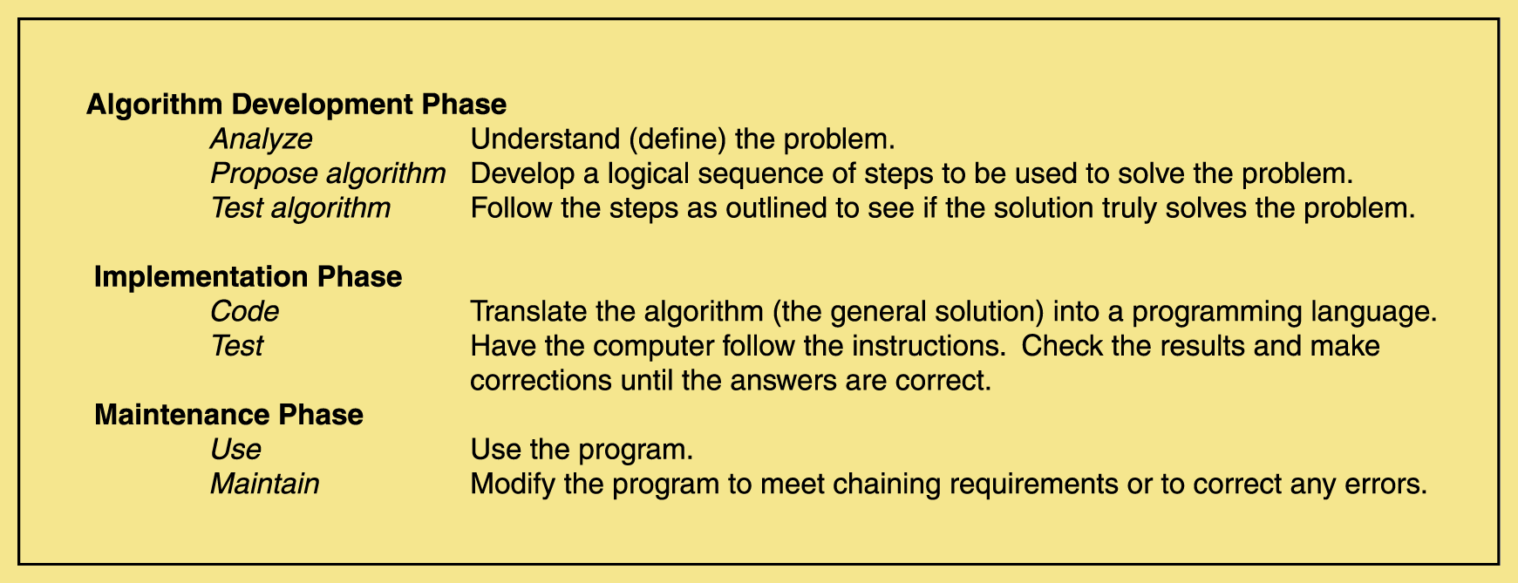
Computer Problem-Solving
Notes:
The Software Development Life Cycle (SDLC), or System Development Life Cycle in systems engineering, information systems and software engineering, is the entire process of formal, logical steps taken to develop a software product. The concept generally refers to computer or information systems.
Phases of SDLC The phases of SDLC include the following: 1. Problem Definition. 2. Program Design. 3. Coding. 4. Debugging. 5. Testing. 6. Documentation. 7. Maintenance. 8. Extension and Redesign
Problem Definition: Problem definition is the basic and primary step of software development life cycle. It includes the goal of system analysis and to determine where the problem is in an attempt to fix the system. This step involves "breaking down" the system in different pieces to analyze the situation. Requirements Gathering is also a step to be taken in this stage. Requirements Gathering sometimes requires individuals/teams from client as well as service provider sides to get detailed and accurate requirements.
2. Program Design: In systems, design functions and operations are described in detail, including screen layouts, business rules, process diagrams and other documentation. The output of this stage will describe the new system as a collection of modules or subsystems. The design stage takes as its initial input the requirements identified in the approved requirements document. Design elements describe the desired software features in detail, and generally include functional hierarchy diagrams, screen layout diagrams, tables of business rules, business process diagrams, pseudo code, and a complete entityrelationship diagram with a full data dictionary. Coding: Modular and subsystem programming code will be accomplished during this stage. Coding includes the application of various logic and internal work done by various specialists. This stage is intermingled with the next in that individual modules will need testing before integration to the main project Debugging: Debugging is the process of removing the errors that occurs during the coding part. Debugging is essential for this stage establishes the platform for further stages of development. Testing: The code is tested at various levels in software testing. Unit, system and user acceptance testing’s are often performed. This is a grey area as many different opinions exist as to what the stages of testing are and how much if any iteration occurs. Documentation: Documentation is the process of writing down every stages and each and every details of the process of life cycle development so that anyone who follows this process may be able to do it in the real sense. Documenting the internal design of software for the purpose of future maintenance and enhancement is done throughout development. Maintenance: Maintaining the system is an important aspect of SDLC. As key personnel change positions in the organization, new changes will be implemented, which will require system updates. Maintenance is the process of keeping the software in its fully functional form and see to that nothing goes wrong. Maintaining and enhancing software to cope with newly discovered problems or new requirements can take far more time than the initial development of the software Extension and Redesign: This is the last step of system design where there is always scope for extension and redesign whenever required. This stage allows for the extension of any part for the advancement of the software or so that the developed software does not become useless. This stage allows further designing and following all the steps again.

Slide 18
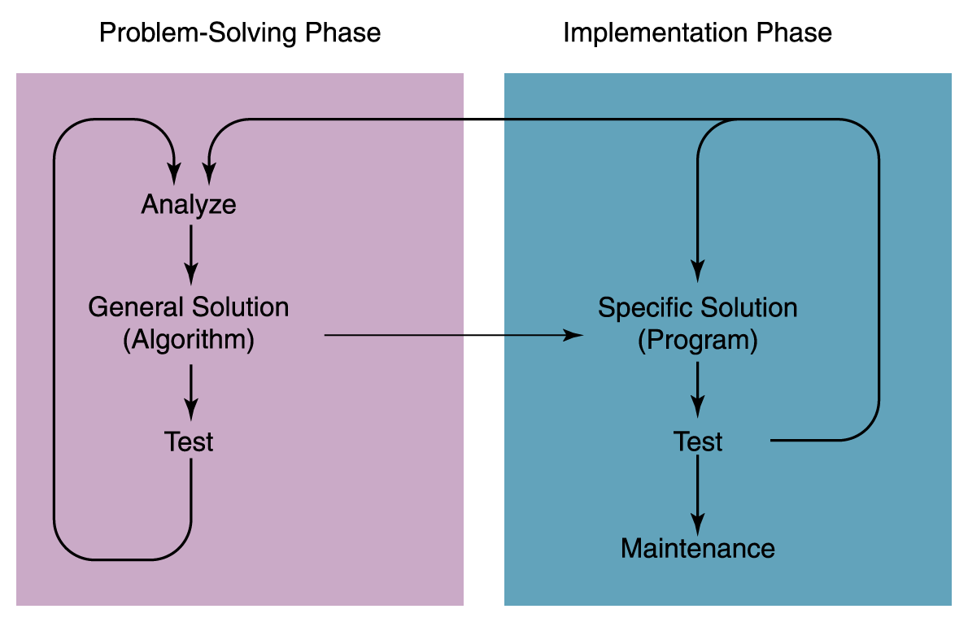
The Interactions Between Problem-Solving Phases
Notes:
The Software Development Life Cycle (SDLC), or System Development Life Cycle in systems engineering, information systems and software engineering, is the entire process of formal, logical steps taken to develop a software product. The concept generally refers to computer or information systems.
Phases of SDLC The phases of SDLC include the following: 1. Problem Definition. 2. Program Design. 3. Coding. 4. Debugging. 5. Testing. 6. Documentation. 7. Maintenance. 8. Extension and Redesign
Problem Definition: Problem definition is the basic and primary step of software development life cycle. It includes the goal of system analysis and to determine where the problem is in an attempt to fix the system. This step involves "breaking down" the system in different pieces to analyze the situation. Requirements Gathering is also a step to be taken in this stage. Requirements Gathering sometimes requires individuals/teams from client as well as service provider sides to get detailed and accurate requirements.
2. Program Design: In systems, design functions and operations are described in detail, including screen layouts, business rules, process diagrams and other documentation. The output of this stage will describe the new system as a collection of modules or subsystems. The design stage takes as its initial input the requirements identified in the approved requirements document. Design elements describe the desired software features in detail, and generally include functional hierarchy diagrams, screen layout diagrams, tables of business rules, business process diagrams, pseudo code, and a complete entityrelationship diagram with a full data dictionary. Coding: Modular and subsystem programming code will be accomplished during this stage. Coding includes the application of various logic and internal work done by various specialists. This stage is intermingled with the next in that individual modules will need testing before integration to the main project Debugging: Debugging is the process of removing the errors that occurs during the coding part. Debugging is essential for this stage establishes the platform for further stages of development. Testing: The code is tested at various levels in software testing. Unit, system and user acceptance testing’s are often performed. This is a grey area as many different opinions exist as to what the stages of testing are and how much if any iteration occurs. Documentation: Documentation is the process of writing down every stages and each and every details of the process of life cycle development so that anyone who follows this process may be able to do it in the real sense. Documenting the internal design of software for the purpose of future maintenance and enhancement is done throughout development. Maintenance: Maintaining the system is an important aspect of SDLC. As key personnel change positions in the organization, new changes will be implemented, which will require system updates. Maintenance is the process of keeping the software in its fully functional form and see to that nothing goes wrong. Maintaining and enhancing software to cope with newly discovered problems or new requirements can take far more time than the initial development of the software Extension and Redesign: This is the last step of system design where there is always scope for extension and redesign whenever required. This stage allows for the extension of any part for the advancement of the software or so that the developed software does not become useless. This stage allows further designing and following all the steps again.

Slide 19
Conveying solution in a formal language
Purpose of program planning
To write a correct program, programmer must write each and every instruction in the correct sequence.
Logic (instruction sequence)of the program can be very complex.
Hence program must be planned before they are written to ensure program instructions are:
Appropriate for the problem
In the correct sequence

Slide 20
Algorithm, Flowchart and Pseudo Code
A typical programming task can be divided into two phases:
1. Problem solving phase
produce an ordered sequence of steps that describe solution of problem
this sequence of steps is called an algorithm
2. Implementation phase
implement the program in some programming language

Slide 21
Algorithm, Flowchart and Pseudo Code
Algorithms, Flowcharts and Pseudo Codes are different tools used for creating new programs, especially in computer programming
Algorithm
Set of step-by-step instructions that perform a specific task or operation
It is a Natural language and NOT programming language
Flowchart
Visual program design tool
Semantic symbols describe operations to be performed
Pseudo code
Set of instructions that mimic programming language instructions

Slide 22
What is an Algorithm?
Step-by-step description of how to achieve a solution for a given problem
refers to the logic of the program or sequence of instructions
It is defined as a sequence of instructions that when executed in the specified sequence, the desired results are obtained.

Slide 23
Algorithm
Algorithm is a representation of a solution to a problem
It is commonly used for data processing, calculation and other related computer and mathematical operations
To be an algorithm, a set of rules must be unambiguous and have a clear stopping point

Slide 24
Characteristics of an Algorithm
Should be precise and unambiguous
Should be executed in a finite time
Should not be repeated infinitely. algorithm will ultimately terminate.
Desired results are obtained
Must have start and stop steps

Slide 25
Example
Algorithm to add two given numbers:
Step 1: START
Step 2: Read two numbers A and B
Step 3: Add numbers A and B and store result in C
Step 4: Display C
Step 5: STOP

Slide 26
Example
Write an algorithm to find the largest among three different numbers entered by user.
Step 1:START
Step 2:Declare variables a,b and c.
Step 3:Read variables a,b and c.
Step 4:If a>b
If a>c
Display a is the largest number.
Else
Display c is the largest number.

Slide 27
Contd…
Else
If b>c
Display b is the largest number.
Else
Display c is the largest number.
Step 5:STOP

Slide 28
Generalized Algorithm
Logic written in universal or general terms
Algorithms are written in general languages which can be used by any one
Knowledge of programming language is not required
Only solution of problem is given, implementation details are not required
Becomes easy to find solution
Anyone can refer this algorithms

Slide 29
How to Make Algorithms Generalized
Solve problem by person who will not be expert in implementation
Use generalized logic to solve problem

Slide 30
Infinite Loop
Loop mean repeat set of instruction till specific condition is true
Infinite loop is endless loop, i.e. it never ends
Infinite loop occurs when condition remains always true or no termination condition exists
Due to infinite loop, program never ends

Slide 31
Avoiding Infinite Loops
Avoided by limiting the number of repetitions of loop
Two ways:
By counting fixed count is used for repeating loop
By using sentinel value It is special value whose presence guarantees termination of loop

Slide 32
Different Ways to Represent an Algorithm
As a flowchart
As a pseudocode
As a program

Slide 33
Program Planning Tools
Flowchart
Structure charts
Pseudo codes

Slide 34
Flowchart
Flowchart is a tool developed in the computer industry, for showing the steps involved in a process
A flowchart is a diagram made up of boxes, diamonds and other shapes, connected by arrows - each shape represents a step in the process, and the arrows show the order in which they occur
Flowcharting Symbols:
There are 6 basic symbols commonly used in flowcharting of assembly language programs: Terminal, Process, input/output, Decision, Connector and Predefined Process

Slide 35
Flowchart
Pictorial representation of an algorithm
Steps of an algorithm are shown in different shapes and logical flow is indicated by arrows
Boxes represent different operations
Arrows shows sequence of operations
Helps to understand logic of program

Slide 36
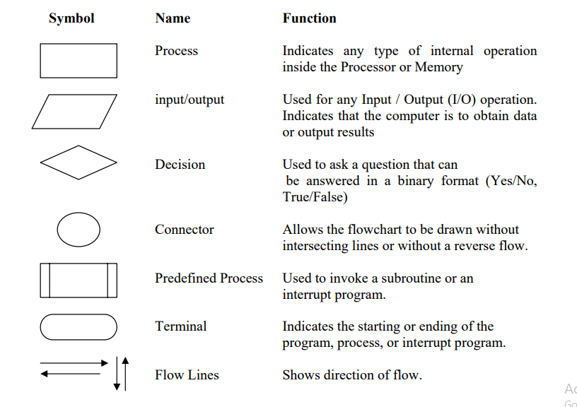
Flowchart Symbols

Slide 37
Flowchart Examples
Add two numbers and display result
START
Read A and B
C=A+B
Display C
STOP

Slide 38
Flowchart Examples
Find the largest of given two numbers
START
Read A and B
Is
A>B
NO
YES
Display A
Display B
STOP

Slide 39
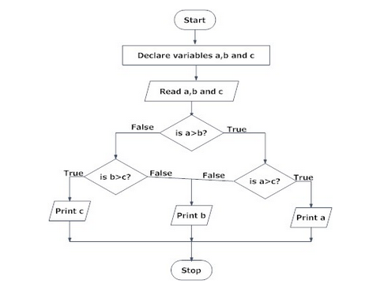
Draw flowchart to find the largest among three different numbers entered by user.

Slide 40
Advantages and Limitations
Advantages:
Better Communication
Proper Program Documentation
Effective Coding
Systematic Debugging
Systematic Testing
Limitations:
Time consuming
Difficult to modify
No update
No standards

Slide 41
Pseudocodes
“Pseudo” – imitation or false
“Code” – instructions written in a programming language
Combination of English and Programming Language
Focuses on developing the logic of the program without worrying about the syntax

Slide 42
Pseudo Code
Pseudo code is one of the tools that can be used to write a preliminary plan that can be developed into a computer program
Pseudo code is a generic way of describing an algorithm without use of any specific programming language syntax
It is, as the name suggests, pseudo code i.e. it cannot be executed on a real computer, but it models and resembles real programming code, and is written at roughly the same level of detail
Computer science textbooks often use pseudo code in their examples so that all programmers can understand them, even if they do not all know the same programming languages

Slide 43
Example
Accept two numbers :-
if first number > second number
display “First number is greater”
else
display “ second number is greater”

Slide 44
Advantages and Limitations
Advantages
Focuses on logic of program without worrying about syntax
Language independent; can be translated to any computer language code
Easier to develop program from pseudocode than flowchart
More concise, readable, and easier to modify
Limitations
No visual representation of program logic
No standards
Cannot be compiled and executed hence correctness cannot be verified

Slide 45
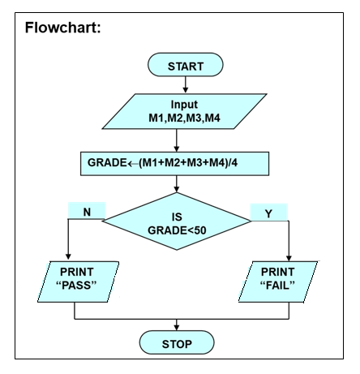
Example: Algorithm, Flowchart and Pseudo Code
Determine a student’s final grade indicating whether he/she is passing or failing. The final grade is calculated as the average of four marks.
Algorithm:
Step 1: Start
Step 2: Input a set of four marks
Step 3: Calculate the grade by adding and dividing by 4
Step 4: if grade is below 50
Print “FAIL”
else
Print “PASS”
Step 5: Stop
Pseudo code:
Read M1,M2,M3,M4
GRADE ← (M1+M2+M3+M4)/4
if (GRADE < 50) then
Print “FAIL”
else
Print “PASS”
endif

Slide 46
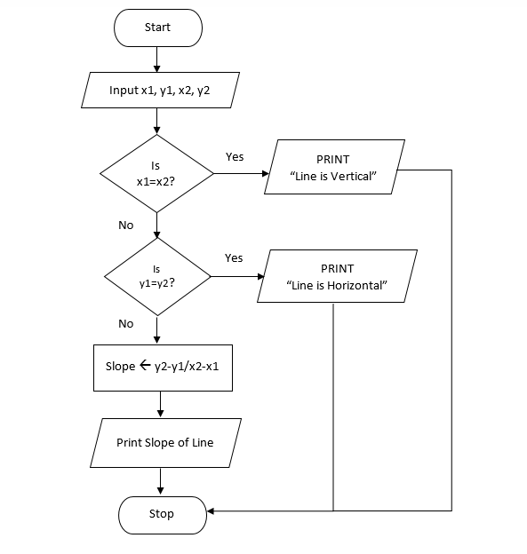
Case Study Algorithm and Flowchart to calculate slope of a line
Algorithm:
Step 1: Start
Step 2: Input x and y coordinates of line as x1, y1, x2, y2
Step 3: if x1 and x2 are equal then
Print “Line is Vertical“
Go to Step 6
else if y1 and y2 are equal then
Print “Line is Horizontal“
Go to Step 6
else Go to Step 4
Step 4: Find Slope as y2-y1/x2-x1
Step 5: Print Slope of Line
Step 6: Stop

Slide 47
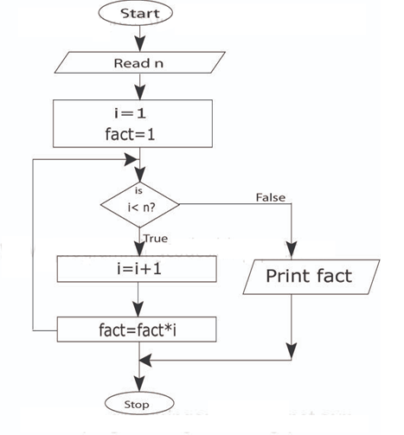
Case Study Algorithm and Flowchart to find factorial of a number
Algorithm:
Step 1 : Start
Step 2 : Read n
Step 3 : Initialize counter variable i to 1 and fact to 1
Step 4 : if i < n go to step 5 otherwise goto step 7
Step 5 : increment counter variable i
Step 6 : calculate fact = fact * i and goto step 4
Step 7 : Print fact
Step 8 : Stop

Slide 48
Case Study Pseudo code to find factorial of a number
Pseudo code:
Input a number n
Initialize counter variable i =1 and factorial=1
while i <= n
factorial = factorial * i
i=i+1
Print factorial of a number

Slide 49
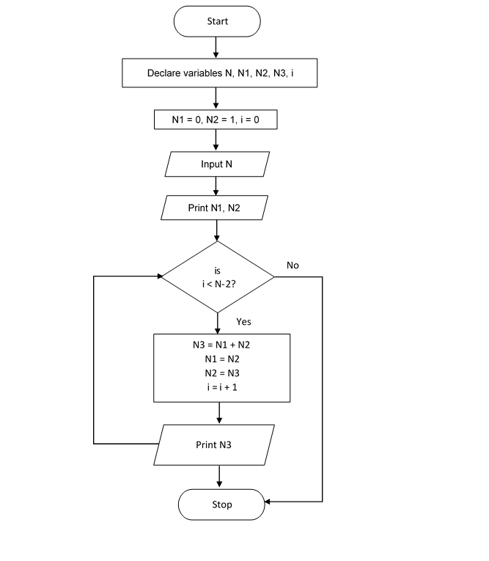
Case Study Algorithm and Flowchart to find Fibonacci Series
Algorithm:
Step 1: Start
Step 2: Declare variables N, N1, N2, N3, i
Step 3: Initialize variables N1 = 0, N2 = 1, i = 0
Step 4: Read value of N from user
Step 5: Display N1, N2
Step 6: Repeat following statements until i < N - 2
Compute N3 = N1 + N2
N1 = N2
N2 = N3
i = i + 1
Display N3
Step 7: Stop

Slide 50
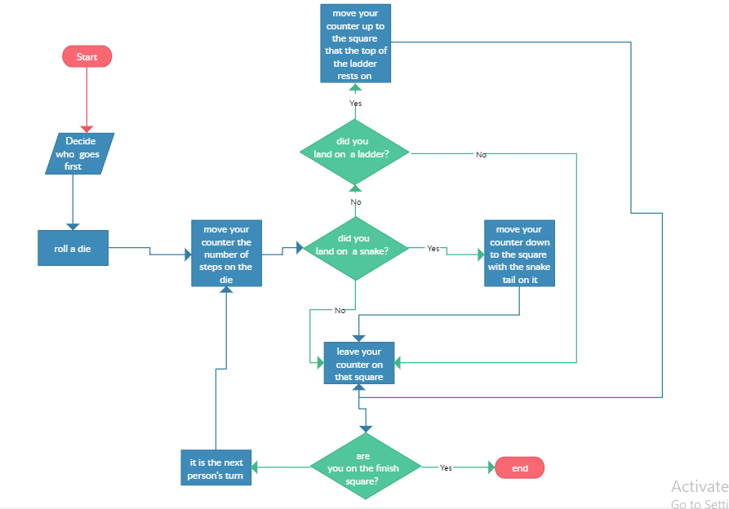
Case Study Flowchart for Snake and Ladder

Slide 51
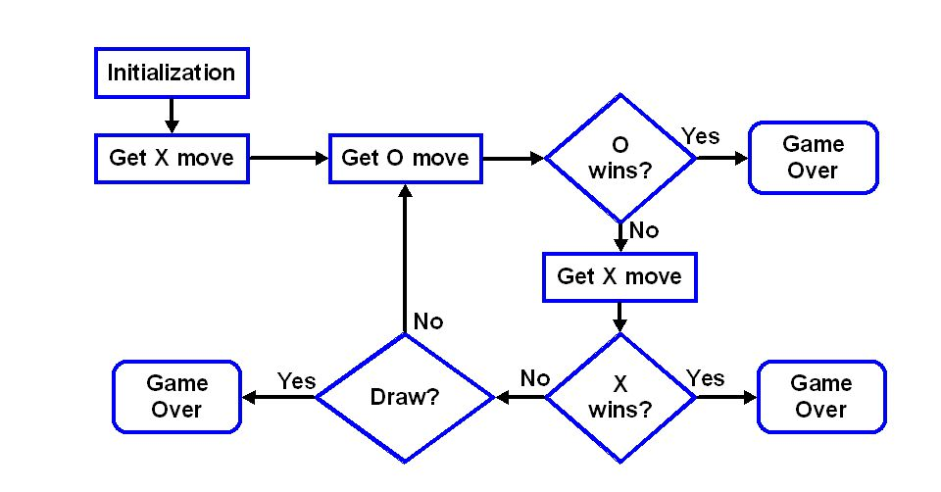
Case Study Flowchart for Tic-Tac-Toe
Start
Print Game Over and O Wins
Print Game Draw
Print Game Over and X Wins
Stop

Slide 52
Top down Design Approach
Top down Design Model
In top-down model, an overview of the system is formulated, without going into detail for any part of it.
Each part of the system is then refined in more details.
Each new part may then be refined again, defining it in yet more details until the entire specification is detailed enough to validate the model.

Slide 53
Contd…
Top down Concept in Problem Solving
If we look at a problem as a whole, it may seem impossible to solve because it is so complex. Examples:
writing a University System program
writing a word processor
Complex problems can be solved using top-down design, also known as stepwise refinement, where
We break the problem into parts
Then break the parts into parts
Soon, each of the parts will be easy to do

Slide 54
Top down Design
Main Task
Subtask 1
Subtask 2
Subtask 3

Slide 55
Top down Design
Quadratic Solver
getEquation
getDelta
getSolution

Slide 56
Advantages of Top-down Design
Breaking the problem into parts helps us to clarify what needs to be done.
At each step of refinement, the new parts become less complicated and, therefore, easier to figure out.
Parts of the solution may turn out to be reusable.
Breaking the problem into parts allows more than one person to work on the solution.

Slide 57
Bottom-up Design
In bottom-up design individual parts of the system are specified in details.
The parts are then linked together to form larger components, which are in turn linked until a complete system is formed.
Object-oriented languages such as C++ or JAVA use bottom-up approach where each object is identified first.

Slide 58
Bottom up Design
Main Task
Subtask 1
Subtask 2
Subtask 3

Slide 59
Software Development Life Cycle (SDLC)
The software development life cycle (SDLC) is a framework defining tasks performed at each step in the software development process
SDLC is a structure followed by a development team within the software organization
It consists of a detailed plan describing how to develop, maintain and replace specific software
The life cycle defines a methodology for improving the quality of software and the overall development process

Slide 60
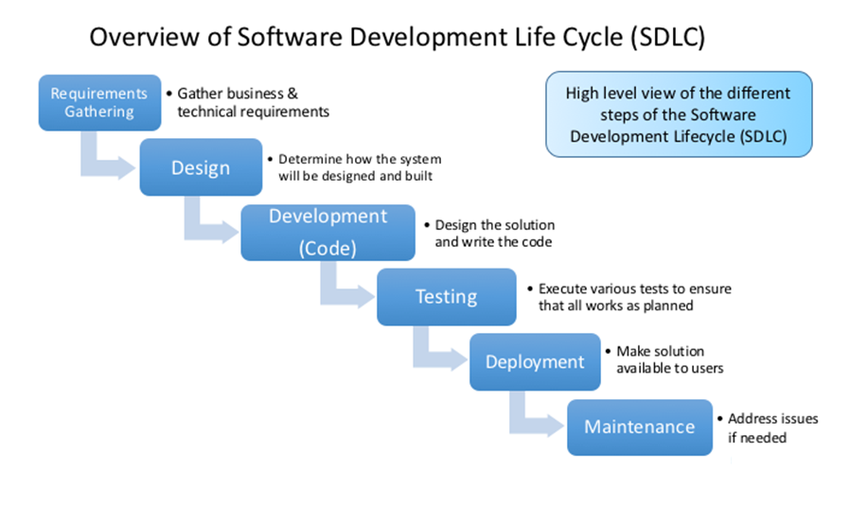
Software Development Life Cycle (SDLC)
Notes:
The Software Development Life Cycle (SDLC), or System Development Life Cycle in systems engineering, information systems and software engineering, is the entire process of formal, logical steps taken to develop a software product. The concept generally refers to computer or information systems.
Phases of SDLC The phases of SDLC include the following: 1. Problem Definition. 2. Program Design. 3. Coding. 4. Debugging. 5. Testing. 6. Documentation. 7. Maintenance. 8. Extension and Redesign
Problem Definition: Problem definition is the basic and primary step of software development life cycle. It includes the goal of system analysis and to determine where the problem is in an attempt to fix the system. This step involves "breaking down" the system in different pieces to analyze the situation. Requirements Gathering is also a step to be taken in this stage. Requirements Gathering sometimes requires individuals/teams from client as well as service provider sides to get detailed and accurate requirements.
2. Program Design: In systems, design functions and operations are described in detail, including screen layouts, business rules, process diagrams and other documentation. The output of this stage will describe the new system as a collection of modules or subsystems. The design stage takes as its initial input the requirements identified in the approved requirements document. Design elements describe the desired software features in detail, and generally include functional hierarchy diagrams, screen layout diagrams, tables of business rules, business process diagrams, pseudo code, and a complete entityrelationship diagram with a full data dictionary. Coding: Modular and subsystem programming code will be accomplished during this stage. Coding includes the application of various logic and internal work done by various specialists. This stage is intermingled with the next in that individual modules will need testing before integration to the main project Debugging: Debugging is the process of removing the errors that occurs during the coding part. Debugging is essential for this stage establishes the platform for further stages of development. Testing: The code is tested at various levels in software testing. Unit, system and user acceptance testing’s are often performed. This is a grey area as many different opinions exist as to what the stages of testing are and how much if any iteration occurs. Documentation: Documentation is the process of writing down every stages and each and every details of the process of life cycle development so that anyone who follows this process may be able to do it in the real sense. Documenting the internal design of software for the purpose of future maintenance and enhancement is done throughout development. Maintenance: Maintaining the system is an important aspect of SDLC. As key personnel change positions in the organization, new changes will be implemented, which will require system updates. Maintenance is the process of keeping the software in its fully functional form and see to that nothing goes wrong. Maintaining and enhancing software to cope with newly discovered problems or new requirements can take far more time than the initial development of the software Extension and Redesign: This is the last step of system design where there is always scope for extension and redesign whenever required. This stage allows for the extension of any part for the advancement of the software or so that the developed software does not become useless. This stage allows further designing and following all the steps again.

Slide 61
Programming Paradigms
A programming paradigm is a pattern of problem-solving thought that underlies a particular genre of programs and languages.
There are four main programming paradigms:
Imperative
Object-oriented
Functional
Logic (declarative)

Slide 62
Imperative Paradigm
Follows the classic von Neumann-Eckert model:
Program and data are indistinguishable in memory
Program = a sequence of commands
State = values of all variables when program runs
Large programs use procedural abstraction
Example imperative languages:
Cobol, Fortran, C, Ada, Perl, …

Slide 63
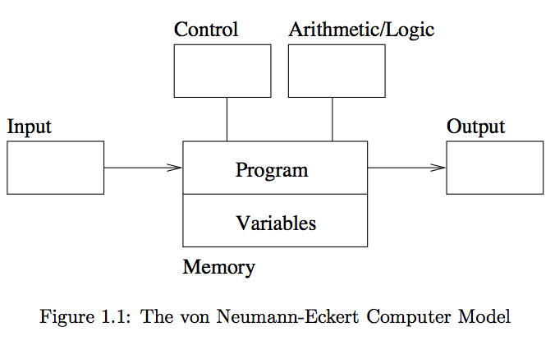
The von Neumann-Eckert Model

Slide 64
Object-oriented (OO) Paradigm
An OO Program is a collection of objects that interact by passing messages that transform the state.
When studying OO, we learn about:
Sending Messages
Inheritance
Polymorphism
Example OO languages:
Smalltalk, Java, C++, C#, and Python

Slide 65
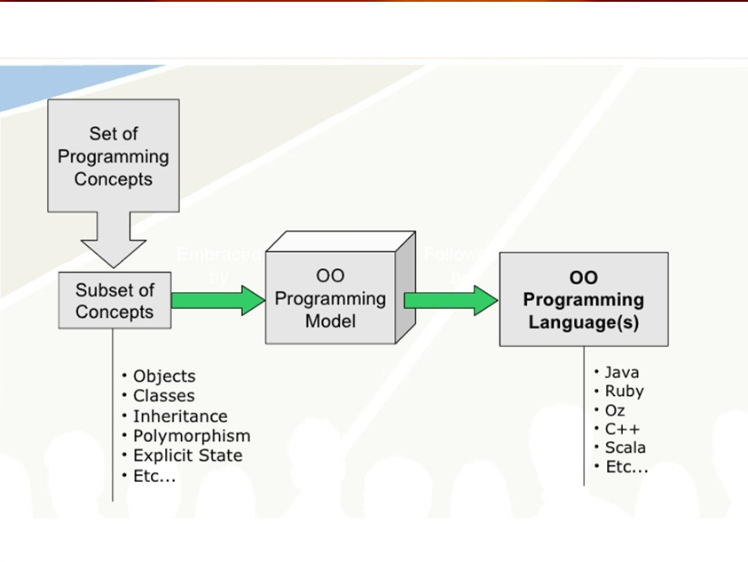
Contd…

Slide 66
Functional Paradigm
Functional programming models a computation as a collection of mathematical functions.
Input = domain
Output = range
Functional languages are characterized by:
Functional composition
Recursion
Example functional languages:
Lisp, Scheme, ML, Haskell, …

Slide 67
Functional vs Imperative
Compute Factorial Function
In Imperative Programming Languages:
In Functional Programming Languages: Scheme
fact(int n) {
if (n <= 1) return 1;
else
return n * fact(n-1);
}
(define (fact n)
(if (< n 1) 1 (* n (fact (- n 1)))
))

Slide 68
Logic Paradigm
Logic programming declares what outcome the program should accomplish, rather than how it should be accomplished.
When studying logic programming we see:
Programs as sets of constraints on a problem
Programs that achieve all possible solutions
Programs that are nondeterministic
Example logic programming languages:
Prolog

Slide 69
Role of Programming Languages
A programming language is formal language that specifies a set of instructions that can be used to produce various kinds of output .
Programming languages generally consist of instructions for a computer .
Programming languages can be used to create programs that implement specific algorithms.

Slide 70
What is Programming Language
A programming language is a notational system for describing computation in machine-readable and human-readable form.
A programming language is a tool for developing executable models for a class of problem domains.

Slide 71
What is Programming Language
English is a natural language. It has words, symbols and grammatical rules.
A programming language also has words, symbols and rules of grammar.
The grammatical rules are called syntax.
Each programming language has a different set of syntax rules.

Slide 72
Steps in learning English Language-
Alphabets
Words
Sentences
Paragraph
Steps in learning C-Language-
Alphabets/
Digits/
Special Symbols
Constants/
Variables/
Keywords
Instructions
Program

Slide 73
Need to Study Programming Language
To improve your ability to develop effective algorithms.
To improve your use of existing programming languages.
To increase your vocabulary of useful programming constructs.
To allow a better choice of programming language.
To make it easier to learn a new language.
To make it easier to design a new language.

Slide 74
Characteristics of Programming Languages
The language must allow the programmer to write simple, clear and concise programs.
It must be simple to use so that a programmer can learn it without any explicit training.
It must be platform independent. That is, the program developed using the programming language can run on any computer system.
The Graphical User Interface (GUI) of the language must be attractive, user-friendly, and self-explanatory.
The function library used in the language should be well documented so that the necessary information about a function can be obtained while developing application.

Slide 75
Characteristics of Programming Languages (Cont…)
Several programming constructs supported by the language must match well with the application area it is being used for.
The programs developed in the language must make efficient use of memory as well as other computer resources.
The language must provide necessary tools for development, testing, debugging, and maintenance of a program. All these tools must be incorporated into a single environment known as Integrated Development Environment (IDE), which enables the programmer to use them easily.
The language must be consistent in terms of both syntax and semantics.

